Slide 1
COMPARATIVE ANALYSIS OF BLOCKCHAIN AUTOMATED FUNCTIONAL TESTING TOOLS
Thesis author: Pavlo Nikolaiev
Scientific supervisor: Dr.sc.ing, associate professor, Egons Lavendelis
Date 20.04.2023

Slide 2
Topicality of the thesis
Blockchain technology is increasingly critical across industries, yet comprehensive evaluations of testing tools remain scarce. This research aims to compare various automated testing tools for blockchain, analyzing their strengths, weaknesses, and suitability for different projects. The goal is to help developers improve the quality and reliability of blockchain systems by selecting the most effective testing tools.

Slide 3
Goal and tasks of the thesis
The goal of the bachelor thesis: To compare existing automated functional testing tools widely used in industry for testing blockchain based solutions.
The tasks of the bachelor thesis:
To analyze blockchain automated functional testing principles,
To overview blockchain technologies in the context of testing,
To analytical compare automated functional testing tools for blockchain technologies and to overview existing comparisons of these tools,
To define the methodology for comparison of automated functional testing tools for blockchain technologies,
To do experimental comparison of automated functional testing tools for blockchain technologies based on particular test scenarios,
To provide guidelines or recommendations for selecting automated functional testing tools for blockchain technologies and demonstrate the use of recommendations/guidelines on realistic scenarios of tool selection.

Slide 4
Content of the thesis
Introduction
Automated Functional Testing tools in Blockchain
Overview of Hardhat,Truffle and Anvil
Comparative Analysis
Conclusion

Slide 5
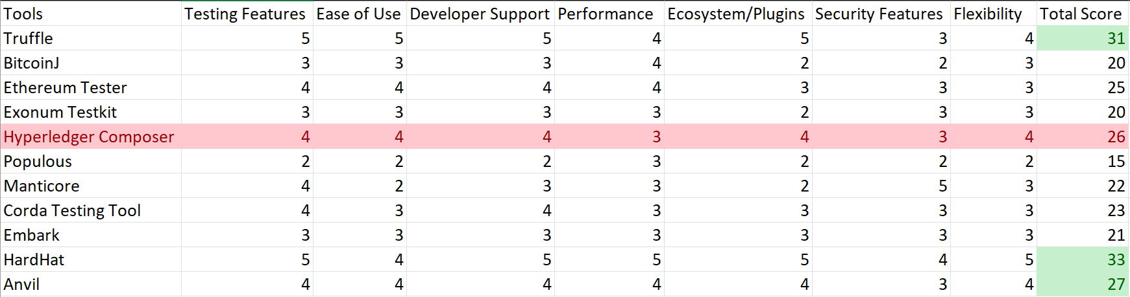
The matrix

Slide 6
Analysis of information sources
Official Documentation and Website Hardhat,Anvil and Truffle
Google scholar
ResearchGate
Cornell University
ScientDerect

Slide 7
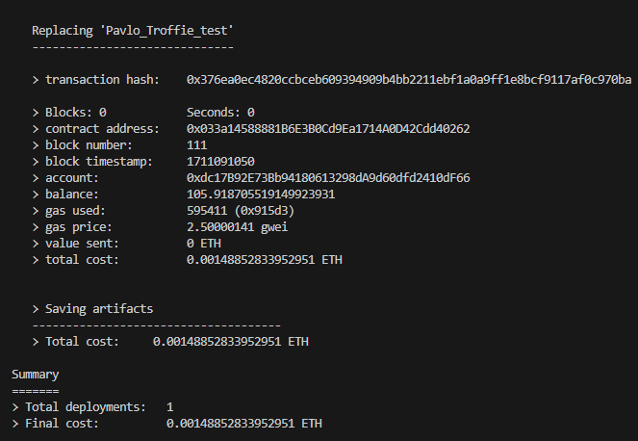
Work done on the thesis
Explanation about blockchain
Analyze the most popular tools
Was write the Test Blockchain application principles
Some major issues in blockchain applications testing was defined
All planes testing tools has bean tested
Blockchain was tested in same scenario

Slide 8
What have bean tested
Unit Testing of Smart Contract Functions: Ensure that each function behaves as expected by testing the logic within the smart contracts. This includes validating inputs and ensuring correct outputs.
Security Testing: Protect your smart contracts from vulnerabilities, such as:
Reentrancy attacks: Verify that the contract is safe from reentrancy exploits.
Overflows/Underflows: Ensure the contract correctly handles integer overflows and underflows.
Access control: Test that functions enforce proper permissions and restrictions.
Integration Testing: If your application has multiple smart contracts, test how they interact with each other. This includes ensuring that state changes in one contract correctly reflect in others and verifying interactions with any external services.
Functional Testing (End-to-End Scenarios): Simulate real user actions and validate that the entire system behaves as expected. For instance, testing user interactions such as placing bids in a marketplace or transferring tokens to ensure smooth operations.

Slide 9
Planned work
More clearly define methodology for comparison
Fix problem related with text formatting
Provide guidelines and recommendations for selecting automated functional testing tools for blockchain technologies

Slide 10
Conclusions and obstacles
Evaluating blockchain testing tools like Hardhat ,Anvil and Truffle involves analyzing their features, user experience, performance, and practical applications. This helps identify which tool is better suited for testing and easier for developers. Performance metrics reveal which executes tests more quickly and efficiently, while case studies showcase real-world effectiveness. However, subjective opinions and project-specific needs can influence comparisons. With my knowledge of Hardhat, I'm challenging myself to create a crypto game on Ethereum, as I believe this innovative technology will soon transform the world.

Slide 11
Testing Features
5: The tool supports a wide range of testing methods (unit, integration, gas, security, etc.) and provides advanced features such as performance analysis.
4: Supports most testing methods but lacks some advanced features.
3: Provides basic testing features like unit and integration testing, but lacks advanced tools like performance or security testing.
2: Limited testing functionality, only supports basic unit tests.
1-0: Minimal or no built-in testing functionality.

Slide 12
Developer Support and Documentation
5: Excellent support with extensive documentation, large active community, and regular updates.
4: Good support with a decent amount of tutorials, but less active community or slower updates.
3: Sufficient documentation and community support, but with limited resources.
2: Limited documentation and minimal community activity.
1-0: Poor or outdated documentation, inactive or nonexistent community.

Slide 13
Performance
5: Excellent performance, handles large-scale testing without issues, provides tools for stress testing.
4: Good performance, capable of handling moderate to large-scale testing.
3: Sufficient for average use cases, but struggles with large-scale tests.
2: Limited performance for large-scale or complex testing environments.
1-0: Poor performance or significant issues with scalability.

Slide 14
Tool Ecosystem and Plugins
5: Very rich ecosystem with multiple plugins and integrations for deployment, debugging, and testing.
4: Good ecosystem with some useful plugins, but less variety.
3: Adequate ecosystem with limited plugins and integrations.
2: Few plugins or extensions available.
1-0: No plugin or ecosystem support.

Slide 15
Security Features
5: Excellent security testing features, including symbolic execution, fuzzing, and vulnerability scanning.
4: Good security testing, but lacks advanced features like symbolic execution.
3: Basic security testing features are available.
2: Limited security testing.
1-0: No security testing capabilities.

Slide 16
Flexibility and Extensibility
5: Highly flexible and easily extensible, supports custom plugins and configurations.
4: Good flexibility, but less customizable than the top tools.
3: Sufficient flexibility for most use cases, but limited customizability.
2: Limited flexibility and hard to extend.
1-0: Rigid, little to no flexibility.

Slide 17
Ease of Use
5: Very easy to use with a user-friendly interface, clear documentation, and quick installation.
4: Easy to use, but requires some prior knowledge of blockchain technology.
3: Moderate learning curve, good documentation but requires more setup or technical understanding.
2: Difficult to set up or requires deep technical knowledge to use.
1-0: Very hard to use with poor documentation or complex setup.

Slide 18
Thank you for your attention! Please, your questions…

